Slide 1


WP3 Data Quality Assurance
Dr Punit Gupta (UCD)

Slide 2
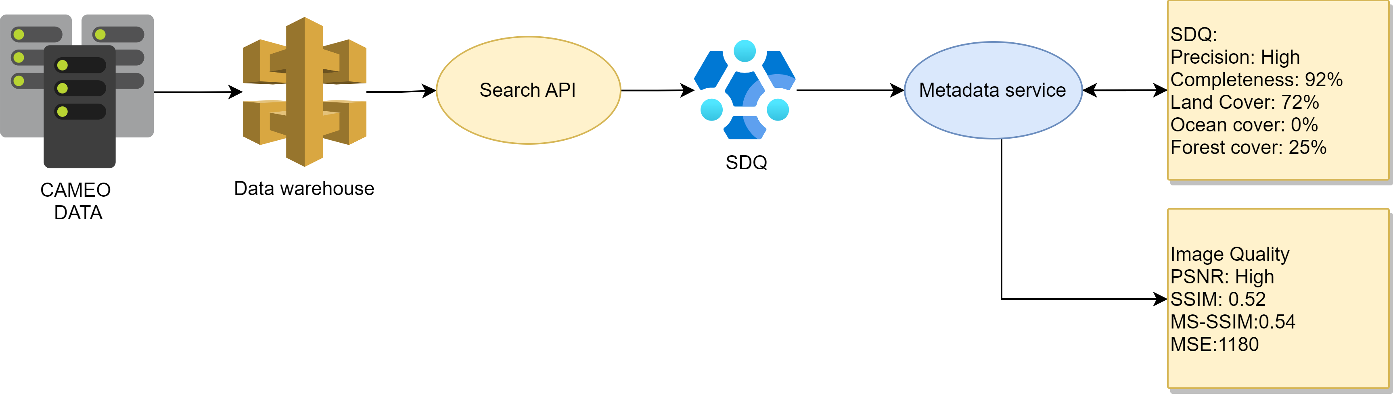


Working Model

Slide 3
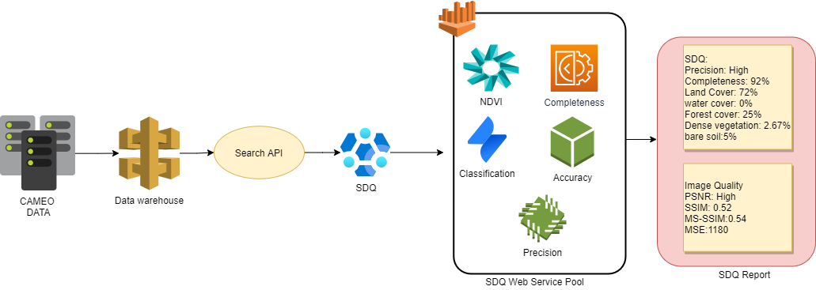
Working Model

Slide 4
Working Model

Slide 5
Working Model
SDQ Interface
Metadata service
Data Service
Data Download & unzip
SQD Services

Slide 6
Working Model
Metadata ID
Fetch Metadata
Fetch data
Integration with Dell service
Data download
Unzip data
Process SDQ
SDQ Report

Slide 7
Current Working
Integration and testing with Dell sample data (done)
Adding microservices
Cloud detection service (ML model)
Atmospheric correction as quality
Thermal noise detection

Slide 8


